Slide 1
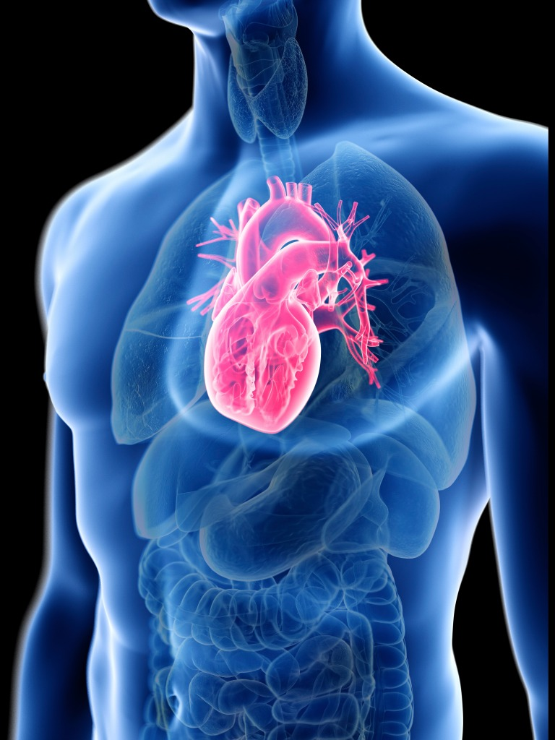
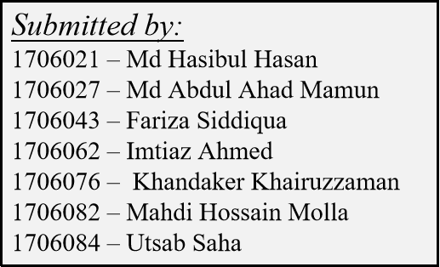
PhonoTrack
A Continuous Heart Rate and Blood Pressure Monitoring System from Phonocardiogram
Group No : 03
Submitted to:
Shahed Ahmed
Lecturer
Department of Electrical and Electronic Engineering
BUET
Md. Jahin Alam
Lecturer(PT)
Department of Electrical and Electronic Engineering
BUET
Project: EEE-426

Slide 2
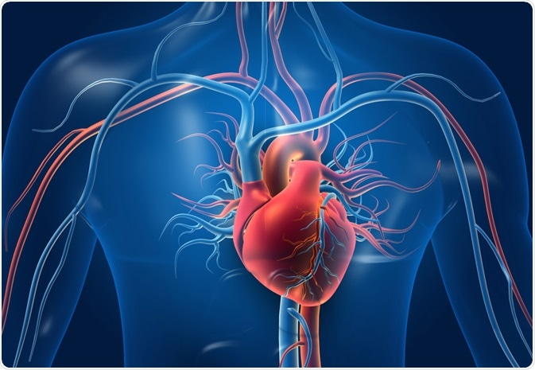
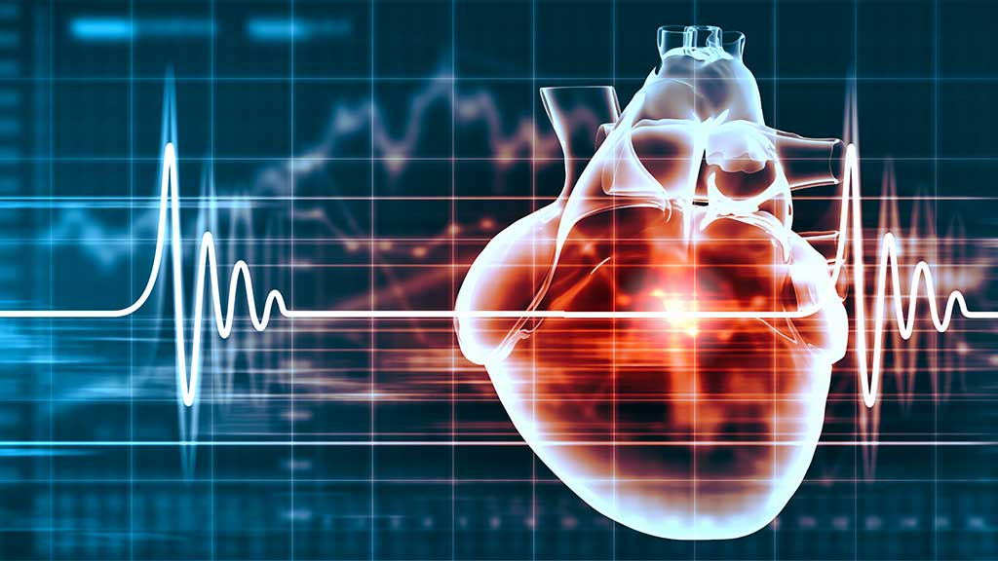
AGENDA
02
Phonocardiogram
Crisis in Cardiovascular Health
Existing Solutions
PhonoTrack
Project Overview
Hardware Module
Components
Algorithm Module : Heart Rate
Algorithm Module : Blood Pressure
Dataset Collection
Dataset
Results
Performance Evaluation
Cost Analysis
Future Prospect
Research outcome
Conclusion
Project: EEE-426

Slide 3
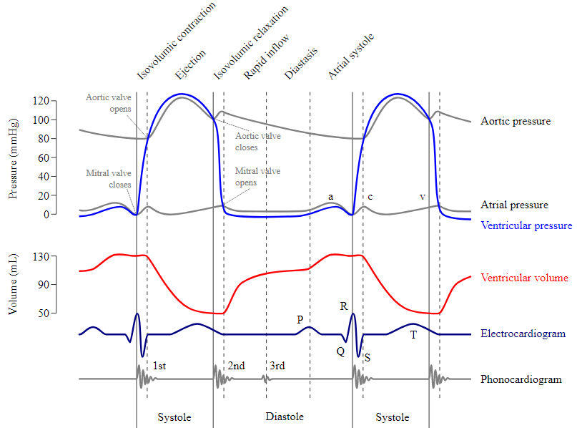
Phonocardiogram(PCG)
The sound of life
03
Phonocardiogram (PCG) signal represents recording of sounds and murmurs resulting from heart auscultation.
A phonocardiogram (or PCG) is a plot of high-fidelity recording of the sounds and murmurs made by the heart with the help of the machine called the phonocardiograph; thus, phonocardiography is the recording of all the sounds made by the heart during a cardiac cycle.
Aortic pressure, Atrial pressure, Ventricular pressure, Ventricular volume and Electrocardiogram are the origin of PCG signal
[1].
Figure 01 : Origin of phonocardiogram Signal
Project: EEE-426

Slide 4
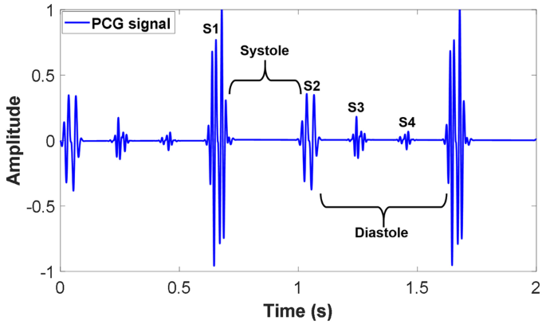
Phonocardiogram(PCG)
The sound of life
04
Phonocardiogram is an important signal to monitor heart health in a noninvasive way.
PCG captures the two distinct sounds from heart
S1 : produced by closure of the mitral and tricuspid valves at the beginning of systole.
S2 : produced by the closure of the aortic and pulmonary valves at the end of systole.
The timing and quality of these sounds can provide valuable information about the heart's function and any potential issues. like-
Murmurs
valve disorders,
congenital heart defects, or
other structural abnormalities
Also a sign of heart failure.
Also many important vital signs can be reliably extracted like Heart Rate and Blood Pressure as this data is comparatively cleaner.
Figure 02 : Different label of PCG Signal
Project: EEE-426

Slide 5
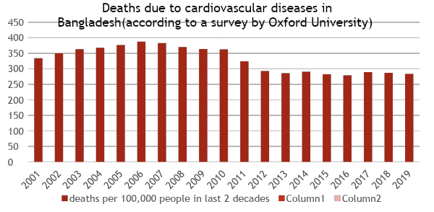
Crisis in Cardiovascular Health
05
Cardiovascular Health Risks in Bangladesh
Need for Constant Monitoring
Fitness and exercise
F
Early detection of health problems
Management of chronic conditions
M
E
[3]
A
2.5 Lakh
Assessment of medication effectiveness
14.31%
30%
Patients die of CVD annually in Bangladesh
The risk of death due to heart diseases
The risk of death due to heart diseases
[2]
[3]
[4]
Project: EEE-426

Slide 6
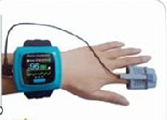
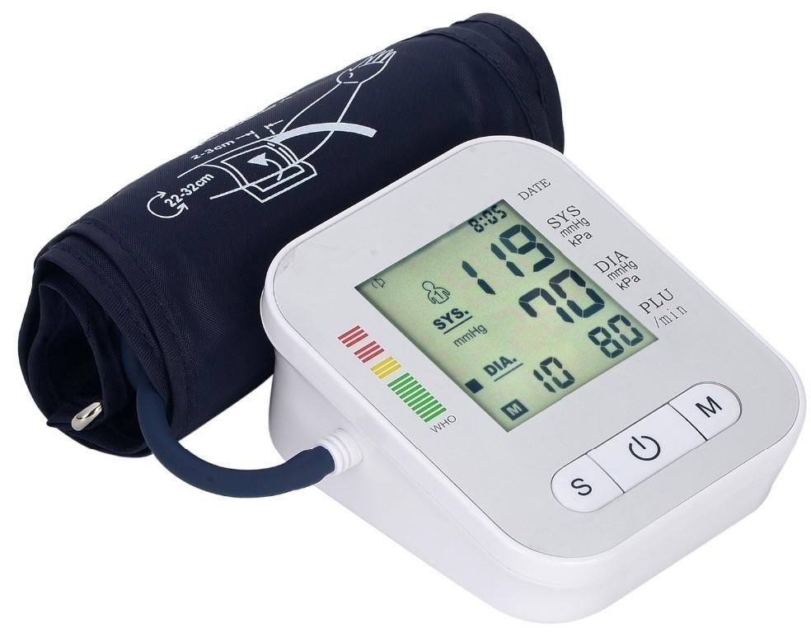
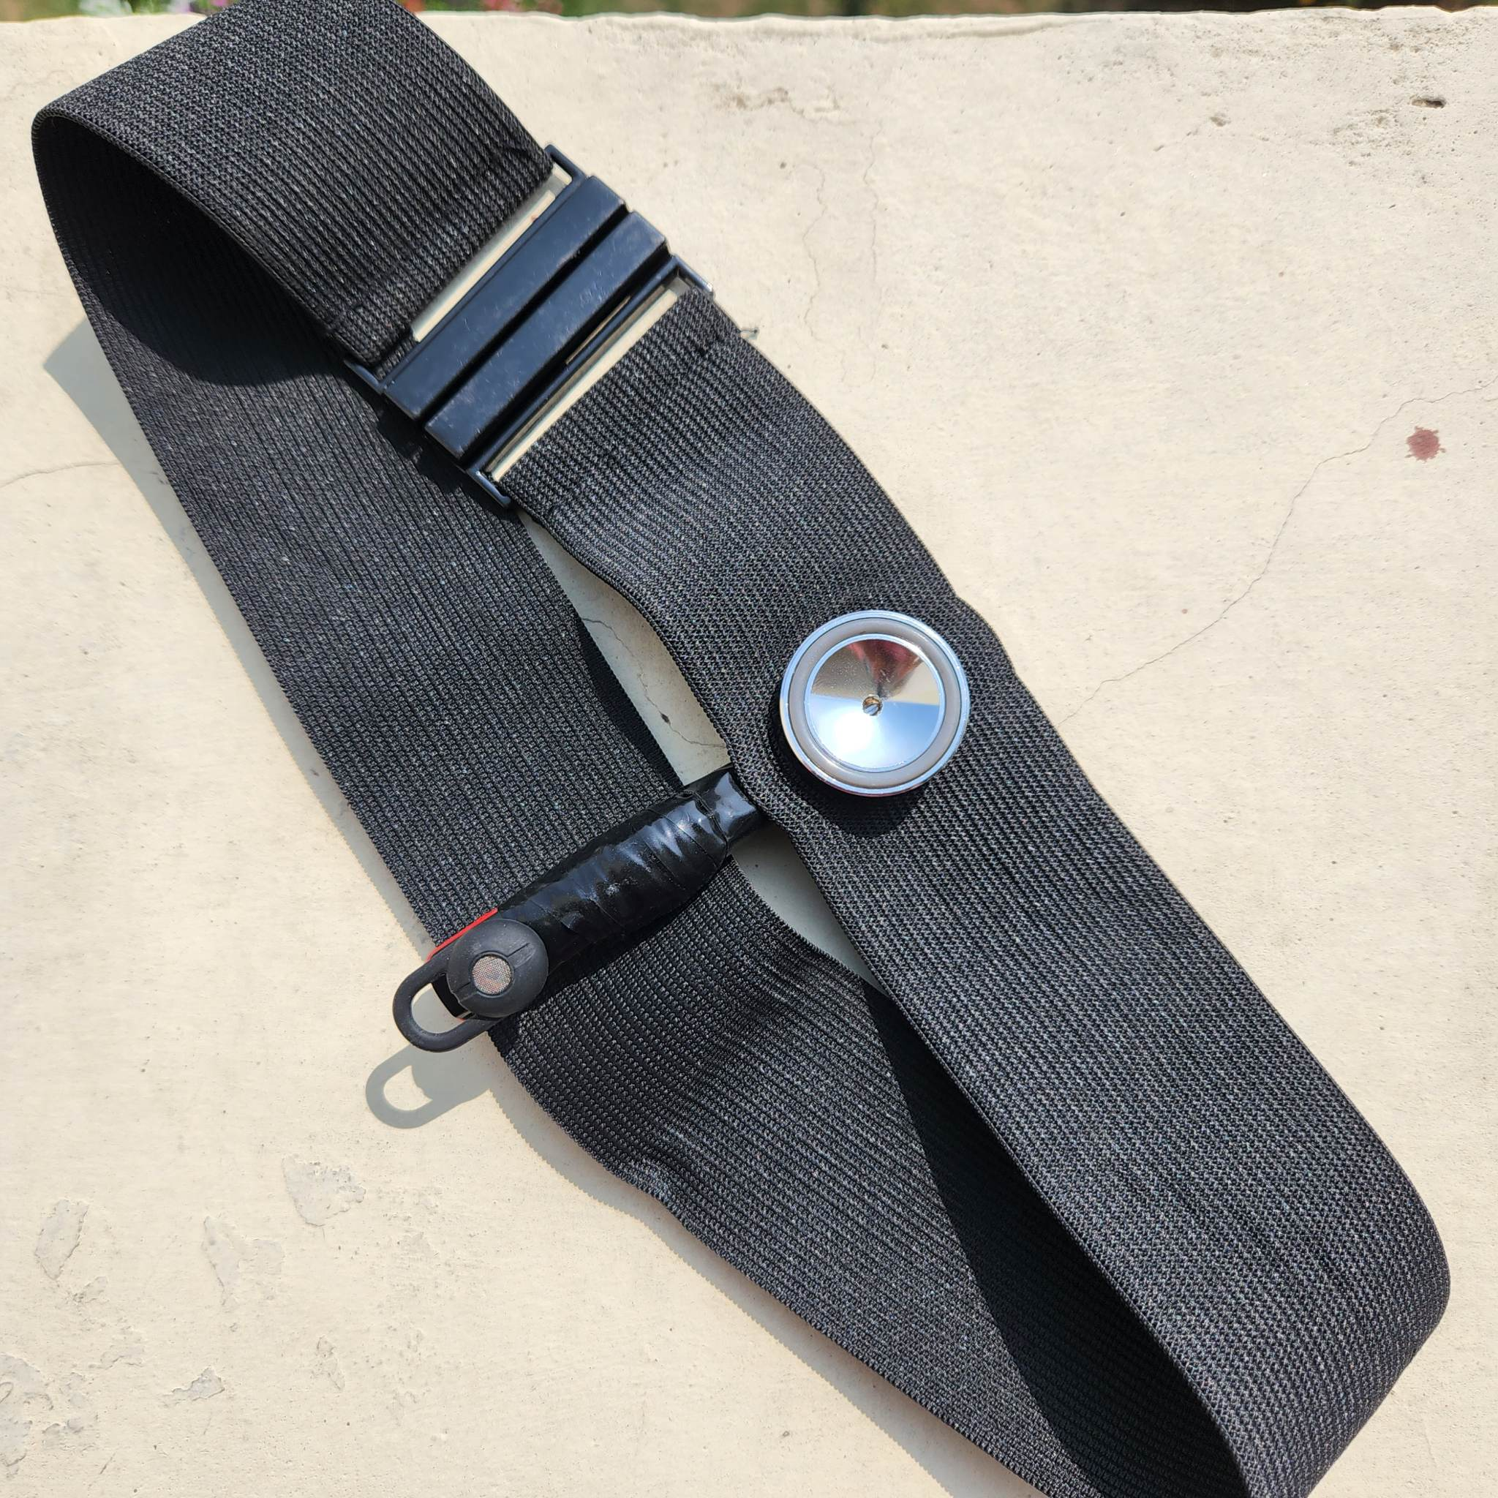
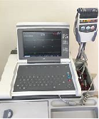
Existing Solutions
06
Digital Sphygmomanometer
✅ Reliable
✅ Cost efficient
❌ Continuous measurement
✅ Compact
✅Both Heart rate and BP
Pulse Oximeter
❌ Reliable
✅ Cost efficient
✅ Continuous measurement
✅ Compact
✅ Both Heart rate and BP
ECG
✅ Reliable
❌ Cost efficient
✅ Continuous measurement
❌ Compact
✅ Bothe Heart rate and BP.
Our Proposed system
✅ Reliable
✅ Cost efficient
✅ Continuous measurement
✅ Compact
✅ Both Heart rate and BP
Project: EEE-426

Slide 7
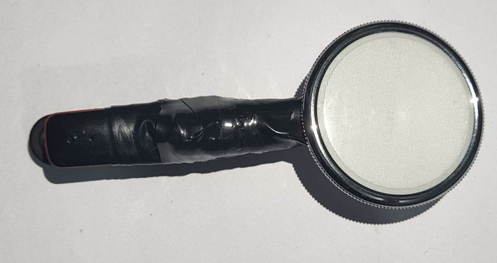
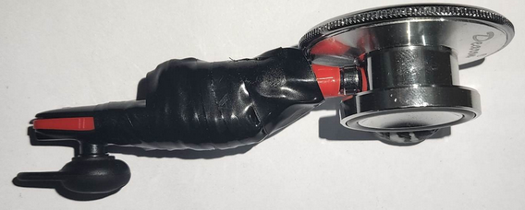
PhonoTrack
A Continuous Monitoring System of HR and BP
07
Input : Heartbeat Sound
Outputs : (for every 8s)
Heart Rate
Blood Pressure
Features:
Continuous Measurement
Powered by charging at regular interval
Weak signal like Bluetooth used, so safe for cardiac patients.
Comparatively cleaner sound acquisition leads to better accuracy.
Cheap and Affordable.
Comfortable and compact for daily usage.
Project: EEE-426

Slide 8
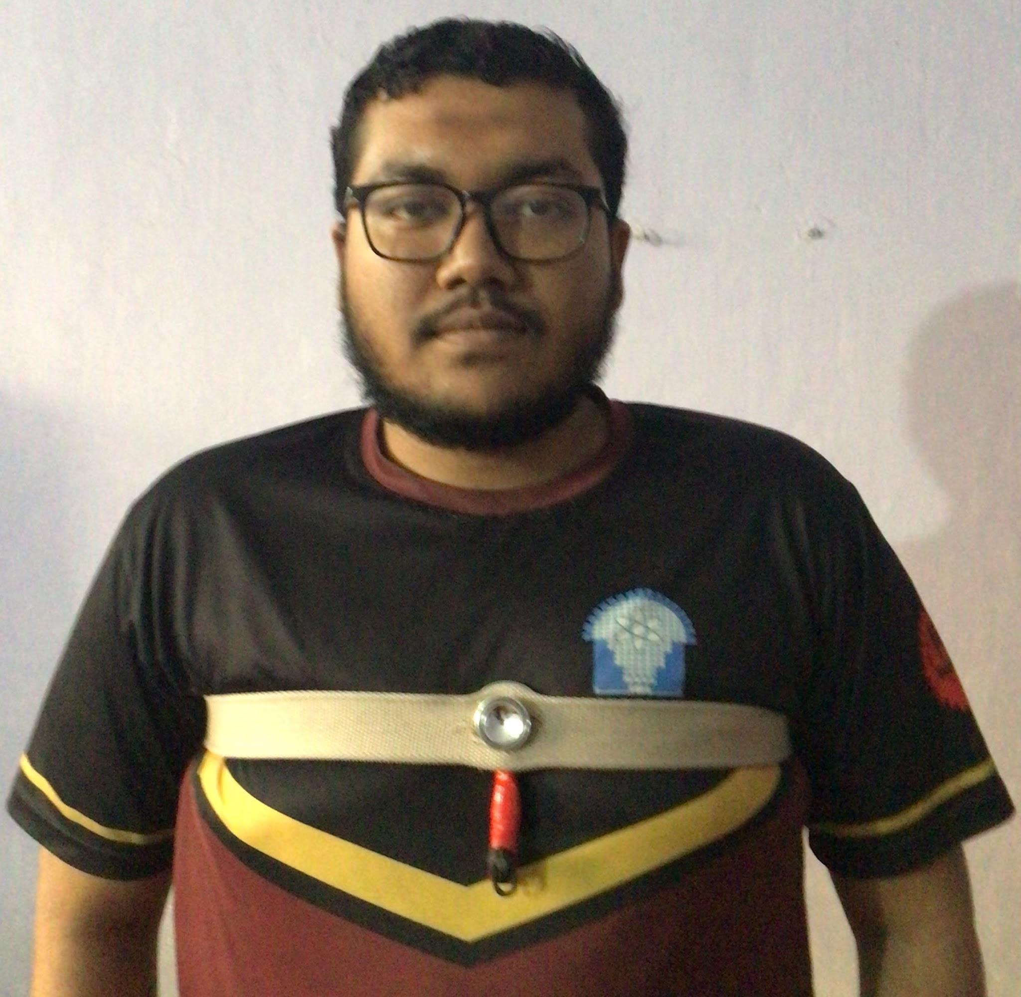


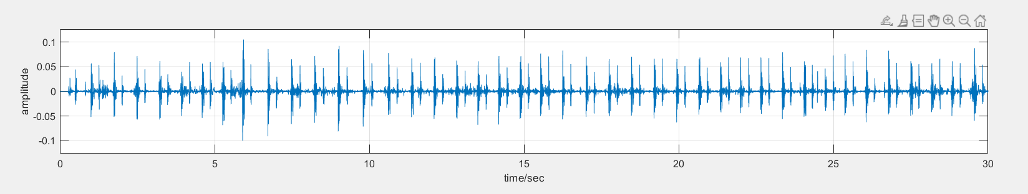
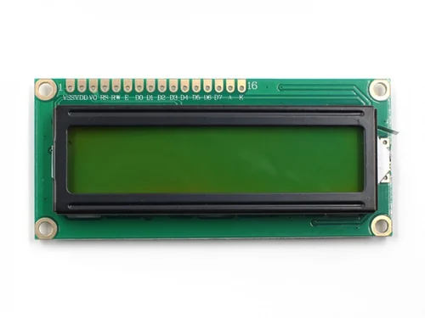

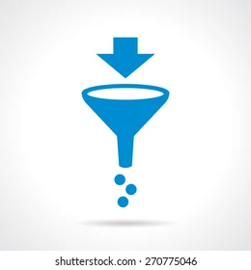
Project Overview
08
Hardware Module
Software Module
Sending to
Laptop
Data Preprocessing
Signal
Acquisition
Data Framing
Output Displaying
Output Generation
Data Denoising
Project: EEE-426

Slide 9
Hardware Module
09
Clinical Diaphragm
Microphone Embedded in Diaphragm
PCG Acquisition via Wire/Bluetooth Module
Signal Processing using MATLAB
Printing in LCD via Arduino
Output From Signal Processing
Project: EEE-426

Slide 10
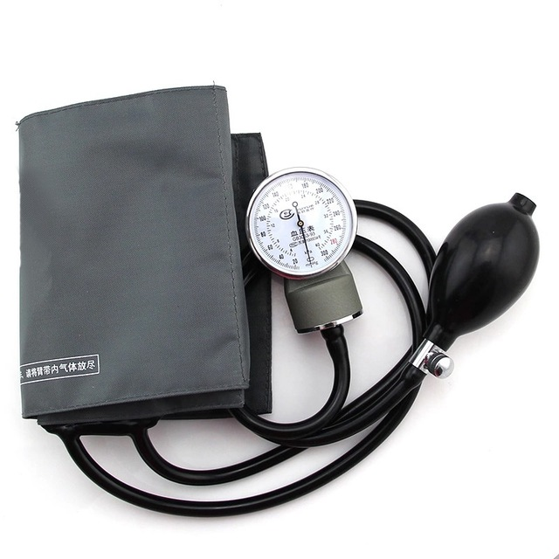
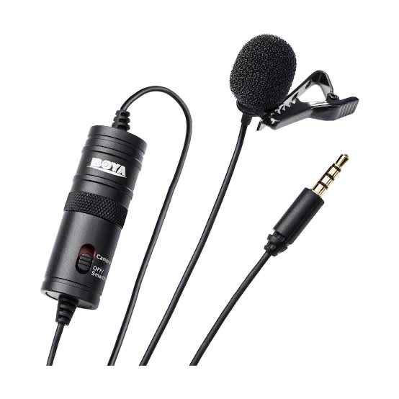
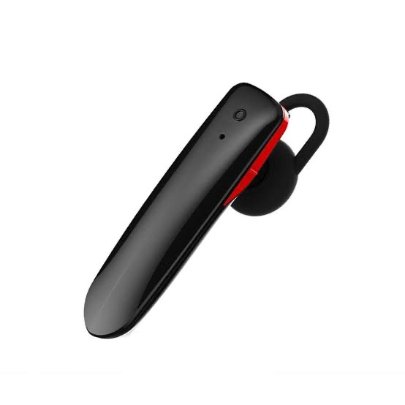
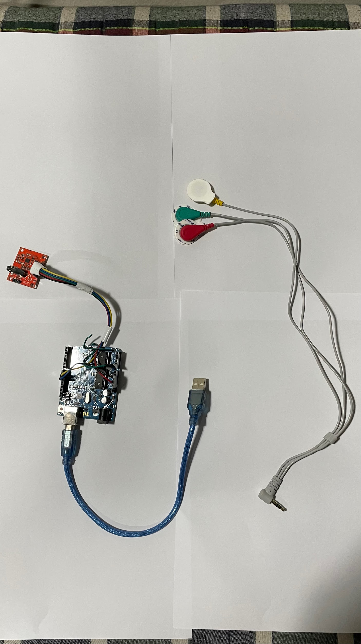
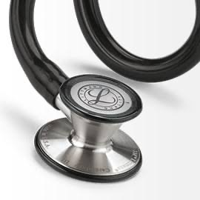
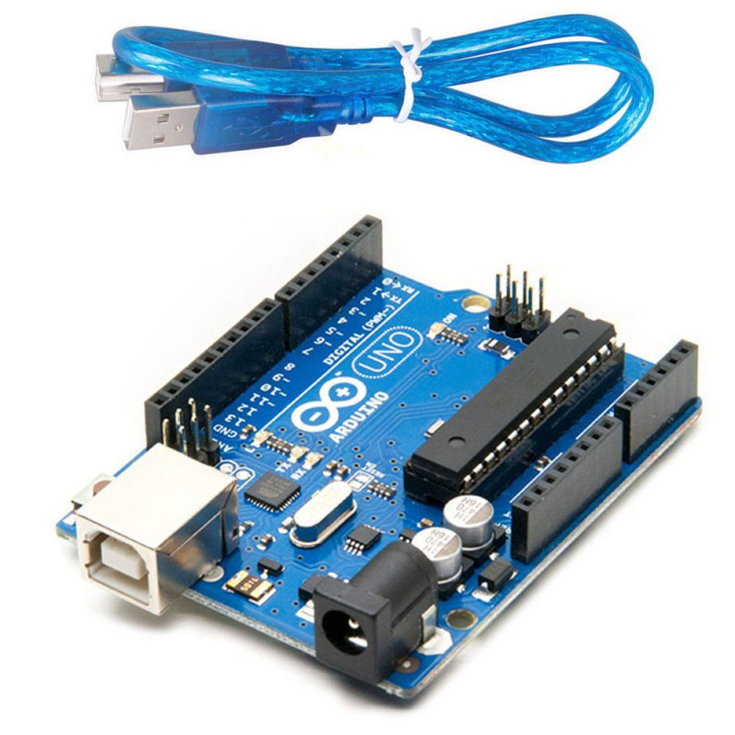
Components
10
3.5 mm condese
Microphone
Bluetooth Microphone
ECG sensor
Sphygmomanometer
Diaphragm
LCD Display
Arduino uno
Digital Sphygmomanometer
Project: EEE-426

Slide 11
Algorithm Module : Preprocessing
11
Signal Acquisition via module
Resampling
Normalization
Scaling
Denoised Signal
Denoising
Extracting Frames
Project: EEE-426

Slide 12
Algorithm Module : HR and BP
12
Denoised Frame
Peak Based Downsampling
Counting Systole Peaks
Thresholding
Feature Extraction
Final HR
Multivariate Regression
Coefficient Extraction
Semi Empirical Equation for BP
BP Estimation
Project: EEE-426

Slide 13
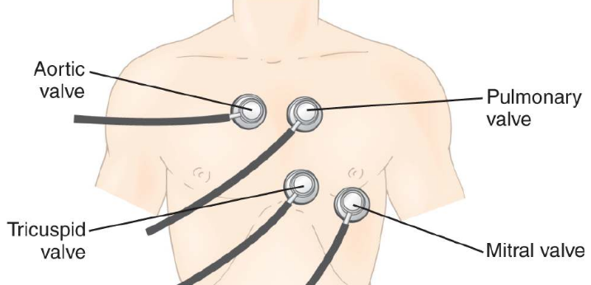
Heart Sound Location
Placement of PhonoTrack device
13
Area | Aortic | Tricuspid | Mitral | Pulmonary
Location of sound | Second intercostal, right sterna border | Fifth intercostal space, left sternal border | Fifth intercostal space, mid- clavicular border | Second intercostal, left sterna border
Timing of sound | Aortic valve is heard here during S2 | Tricuspid valve is heard here during S1 | Mitral valve is heard here during S1 | Pulmonary valve is heard here during S2
Figure 03: Placement of PhonoTrack device
The region of Tricuspid and pulmonary is the best placement for PCG signal.
Project: EEE-426

Slide 14
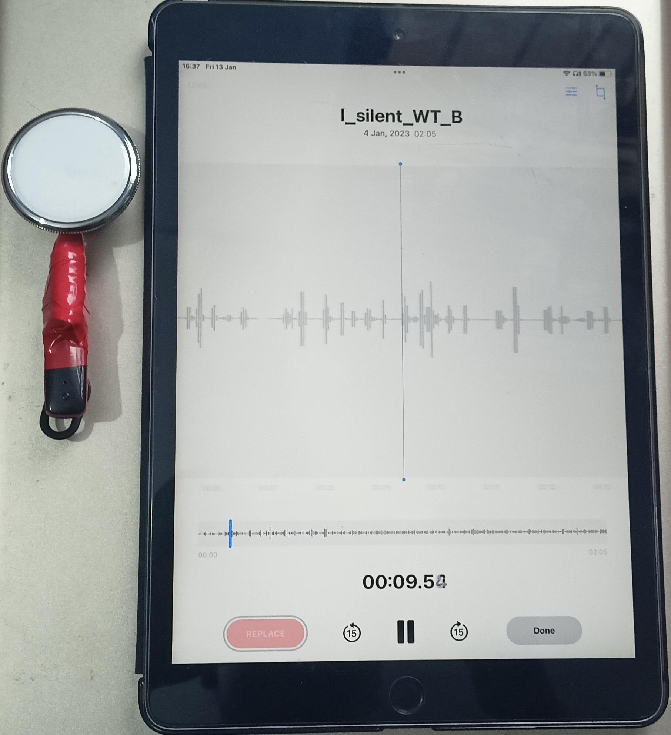
Dataset Collection
Setup-1 (Bluetooth system)
14
Diaphragm
System
Belt
Bluetooth
On/Off switch
Recording Device
Recording System
Setup in Human chest
Project: EEE-426

Slide 15
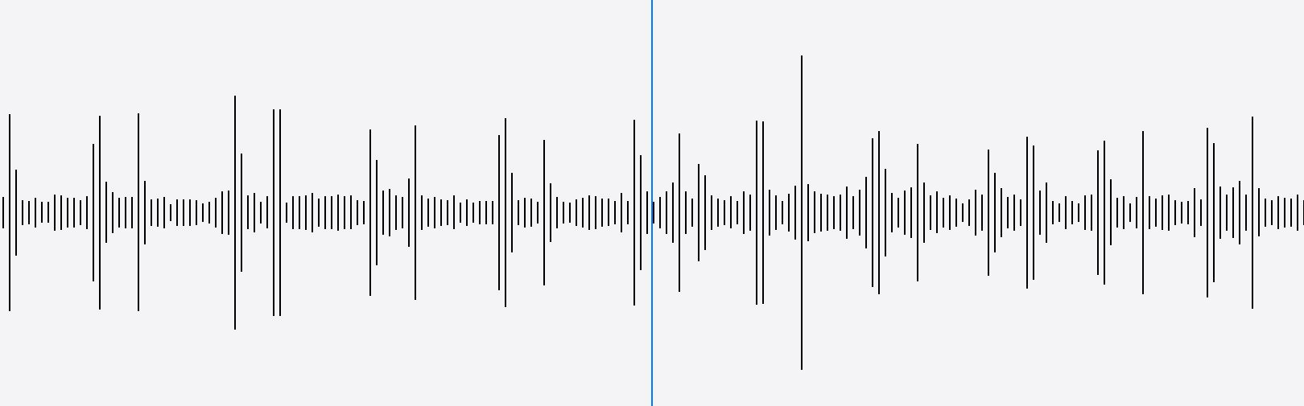
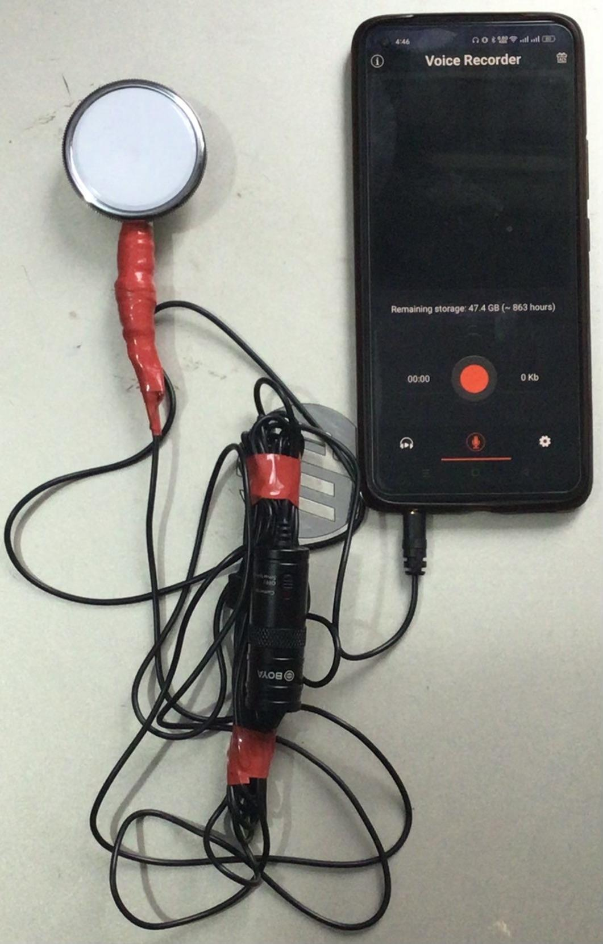
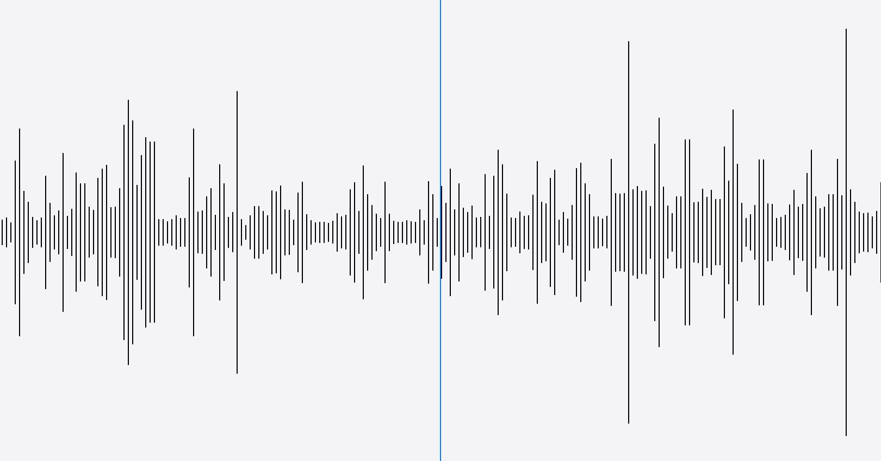
Dataset Collection
Setup-2 (Wired system)
15
Diaphragm
Recording Device
Activity: Silent, Not walking
On/Off switch
Recording System
Activity: Normal, walking
Project: EEE-426

Slide 16
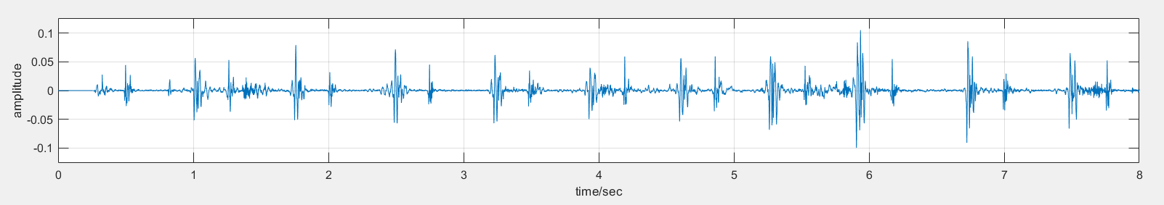
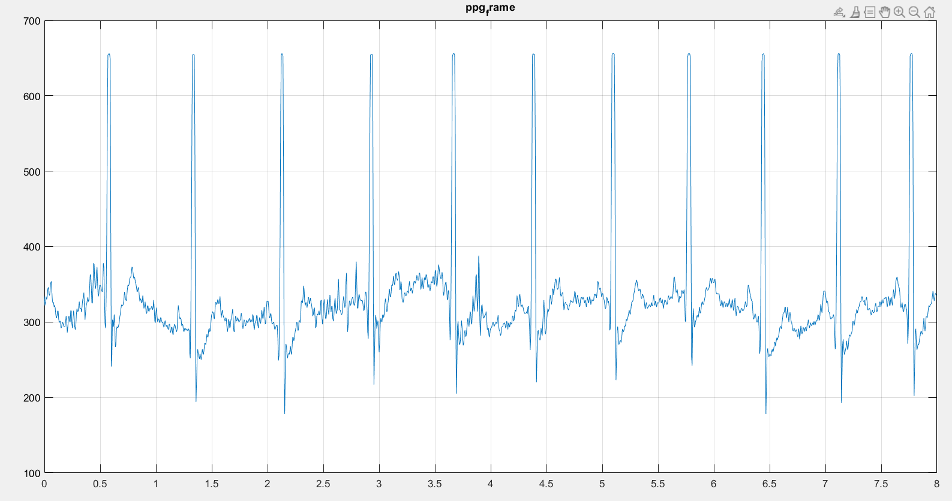
Dataset
16
Our dataset contains mean BP and simultaneous ecg frames for ppg data in 21 subjects with 19 subjects having average HR during data acquisition.
Data was collected from Tricuspid and Pulmonary region to ensure better SNR.
Dataset Descriptions:
Frame Length: 8 Seconds
Average Frames: 15 Frames/subjects
Frame Type: Non-overlapping
Collection region: Tricuspid, Pulmonary
Activities: Standing, sitting, walking,
After light exercise
Sampling Freq: 8000 Hz.
Dataset Summary:
Total PCG Frames : 315 Frames (with ECG + BP)
285 Frames (with avg HR + BP)
Train_test_split : Train dataset (12 subjects)
Test dataset (9 subjects)
Figure 04(a): 8s long PCG frame
Figure 04(b): 8s long PCG frame
Project: EEE-426

Slide 17
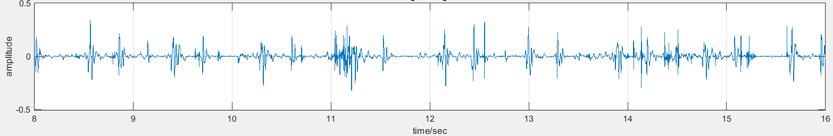
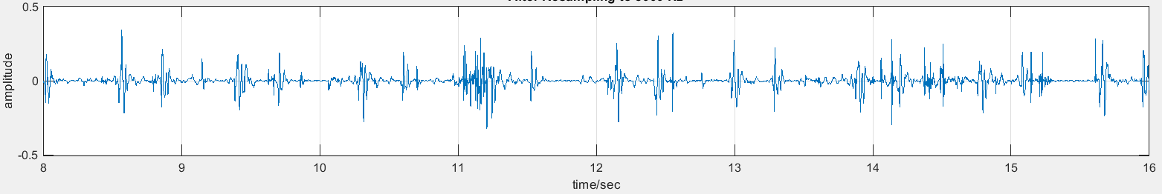
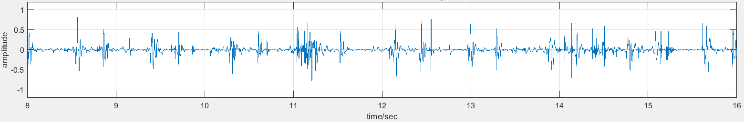
Results (Preprocessing Signals)
17
Figure 05(a) : Original Signal ( 8s frame)
Figure 05(b) : After Resampling at 8000 Hz (8s frame)
Figure 05(c) : After Normalization and Scaling (8s frame)
Project: EEE-426

Slide 18
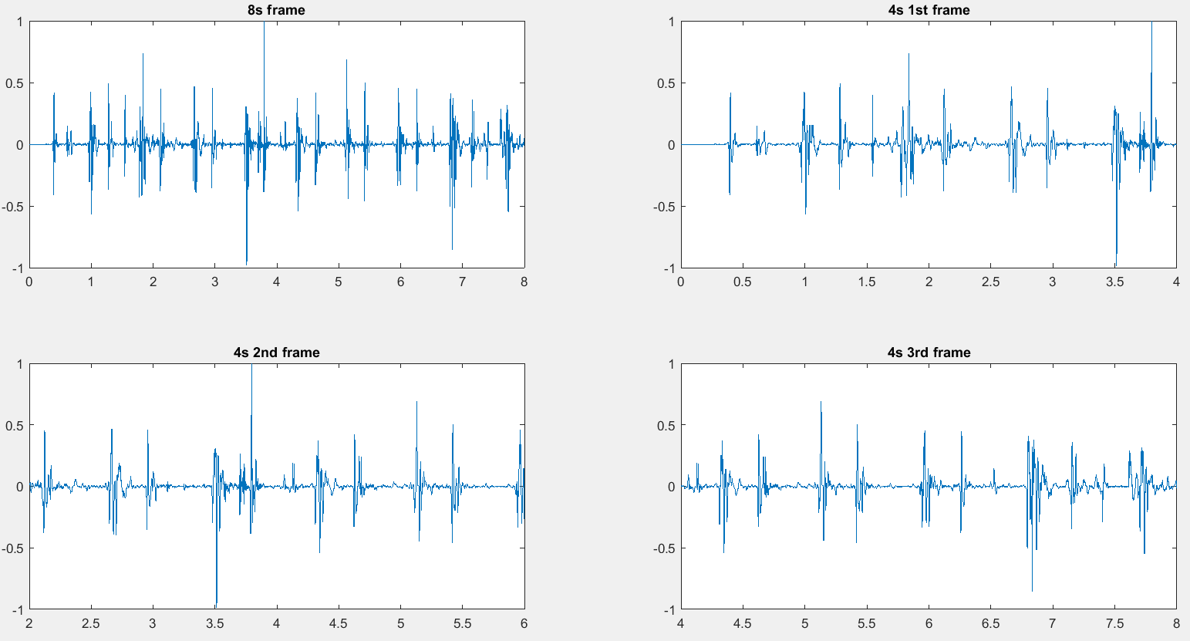
Results (Frame Extraction)
18
(a)
(b)
(c)
(d)
We have extracted 8s non overlapping frames (a), and for each frame we have used three 4s overlapping frame: 0th -4th sec (b), 2nd -6th sec (c), 4th -8th sec (d) to increase credibility of our Heart Rate estimation.
Project: EEE-426

Slide 19
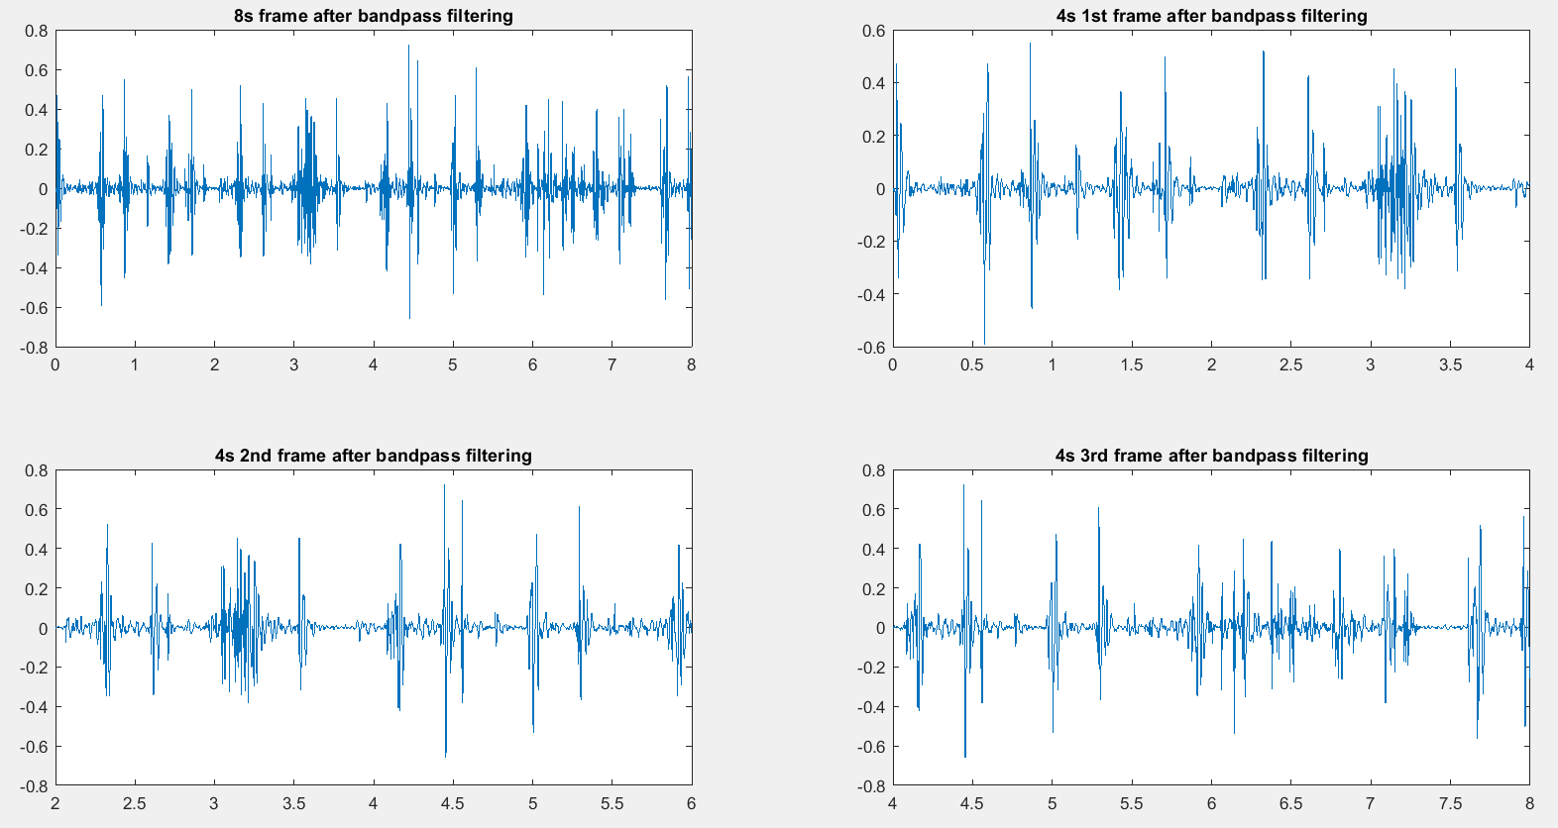
Results (After Bandpass filtering)
19
(a)
(b)
(c)
(d)
After framing, Bandpass filtering was done in 20-200 Hz frequency range with 3rd order Butterworth filter to reduce highest frequency noises.
Project: EEE-426

Slide 20
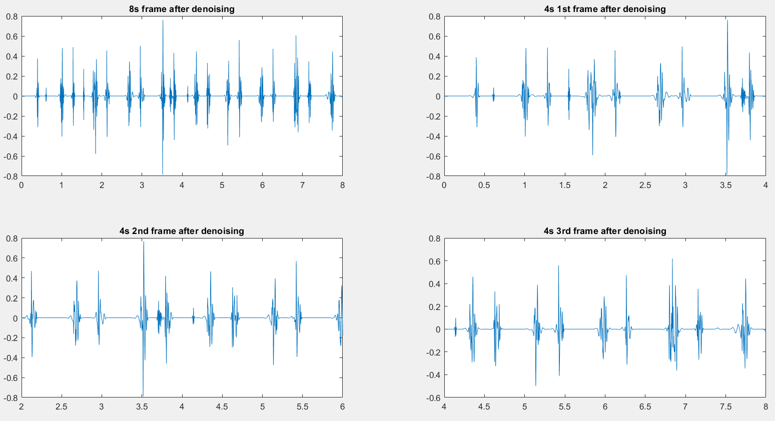
Results (Frames after wavelet denoising)
20
In the next step, Wavelet based denoising is used to reduce contribution from other sounds like environmental sounds, breathing sounds etc.
Wavelet based denoising is done in 3 steps:
Wavelet transform to 8 scales
Thresholding each scales.
Reconstructing the frame using inverse wavelet transform.
(a)
(b)
(c)
(c)
Project: EEE-426

Slide 21
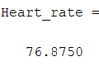
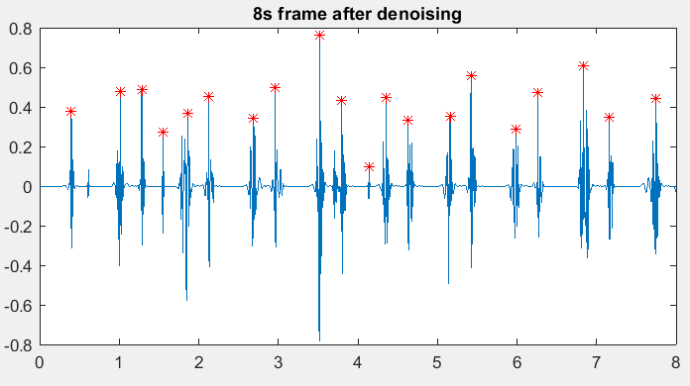
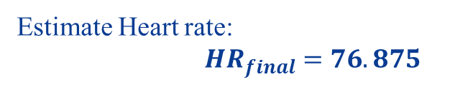
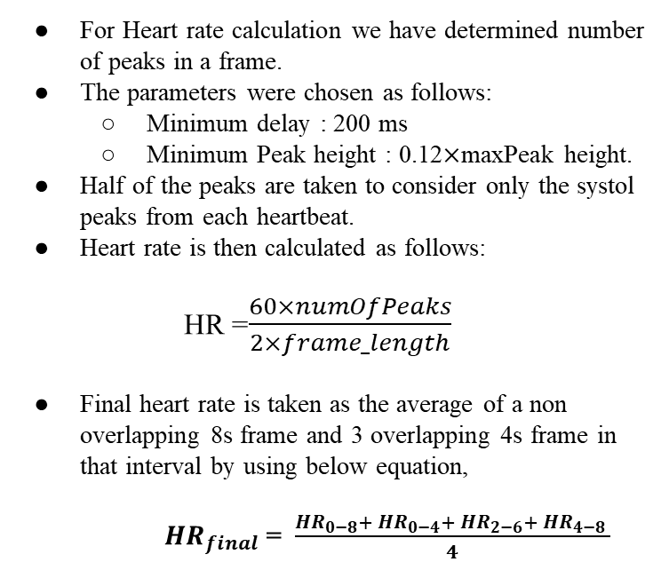
Results (HR using Peak Extraction)
21
For Heart rate calculation we have determined number of peaks in a frame.
The parameters were chosen as follows:
Minimum delay : 200 ms
Minimum Peak height : 0.12$×$maxPeak height.
Half of the peaks are taken to consider only the systol peaks from each heartbeat.
Heart rate is then calculated as follows:
HR =$\frac{60×numOfPeaks}{2×frame_length}$
Final heart rate is taken as the average of a non overlapping 8s frame and 3 overlapping 4s frame in that interval by using below equation,
${ HR}_{final}$ = $\frac{{HR}_{0−8}+ {HR}_{0−4}+ {HR}_{2−6}+ {HR}_{4−8} }{4}$
Figure 06: predicted Heart rate by HR algorithm
Estimate Heart rate:
${ HR}_{final} =76.875$
Project: EEE-426

Slide 22
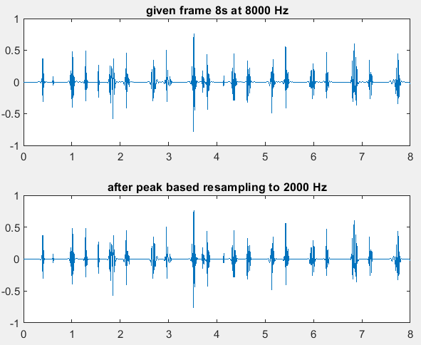
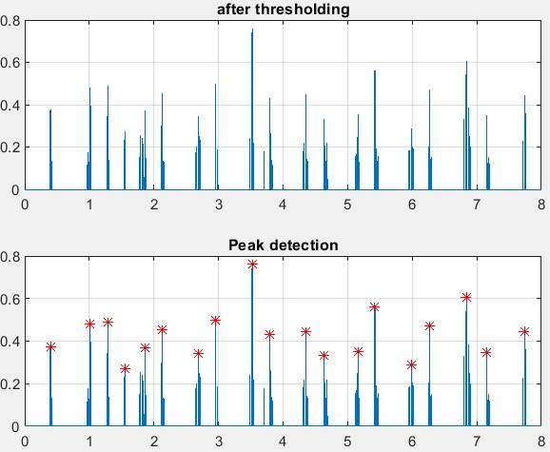
Results (BP components extraction)
22
At first we resampled every 8s frame from 8000 Hz to 2000 Hz, preserving peaks.
After that, we have acquired systole and diastole peaks above a certain range and used these to acquire features.
Project: EEE-426

Slide 23
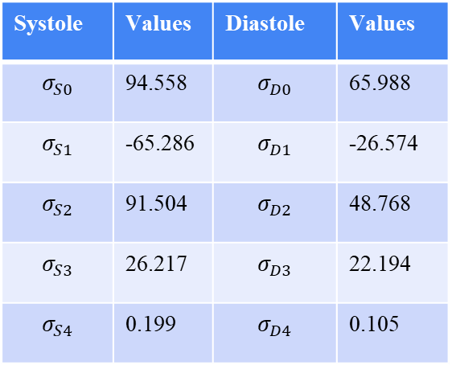
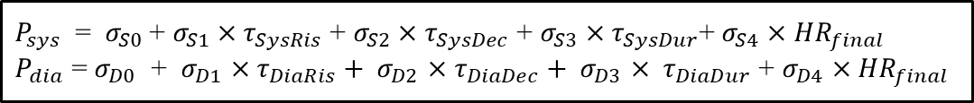
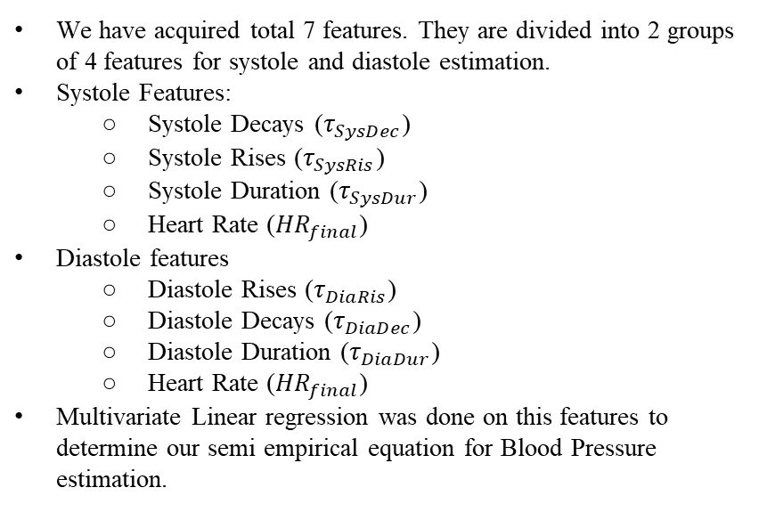
Results (Semi Empirical Model)
23
We have acquired total 7 features. They are divided into 2 groups of 4 features for systole and diastole estimation.
Systole Features:
Systole Decays ($τ_{SysDec}$)
Systole Rises ($τ_{SysRis}$)
Systole Duration ($τ_{SysDur}$)
Heart Rate (${HR}_{final}$)
Diastole features
Diastole Rises ($τ_{DiaRis}$)
Diastole Decays ($τ_{DiaDec}$)
Diastole Duration ($τ_{DiaDur}$)
Heart Rate (${HR}_{final}$)
Multivariate Linear regression was done on this features to determine our semi empirical equation for Blood Pressure estimation.
Systole | Values | Diastole | Values
$$σ_{S0}$$ | 94.558 | $$σ_{D0}$$ | 65.988
$$σ_{S1}$$ | -65.286 | $$σ_{D1}$$ | -26.574
$$σ_{S2}$$ | 91.504 | $$σ_{D2}$$ | 48.768
$$σ_{S3}$$ | 26.217 | $$σ_{D3}$$ | 22.194
$$σ_{S4}$$ | 0.199 | $$σ_{D4}$$ | 0.105
Semi empirical model parameter
Semi empirical model:
$P_{sys}$ = $σ_{S0}$ + $σ_{S1}×τ_{SysRis}$ + $σ_{S2}×$ $τ_{SysDec}$ + $σ_{S3}$ $×τ_{SysDur}$+ $σ_{S4}$ $×$ ${HR}_{final}$
$P_{dia}$ = $σ_{D0}$ + $σ_{D1}$ $×τ_{DiaRis}+ σ_{D2}$ $×$ $τ_{DiaDec}+ σ_{D3}$ $× τ_{DiaDur}$ + $σ_{D4}$ $×$ ${HR}_{final}$
Project: EEE-426

Slide 24
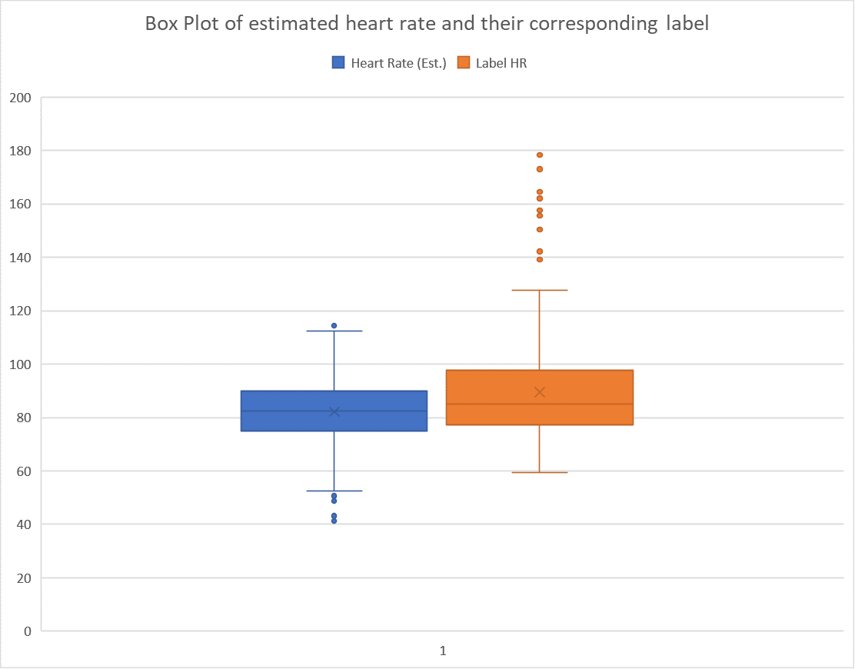
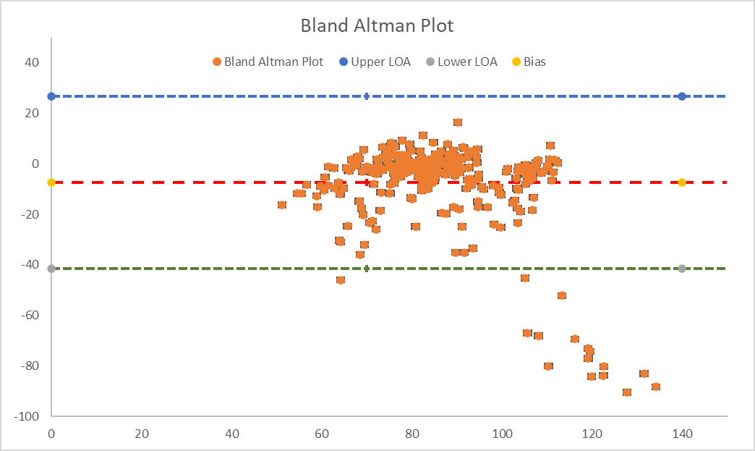
Performance Evaluation : HR
24
Figure 07: Comparison between Label HR and Estimate HR.
Figure 08: Error plot of HR in total Dataset with respect to Label..
Project: EEE-426

Slide 25
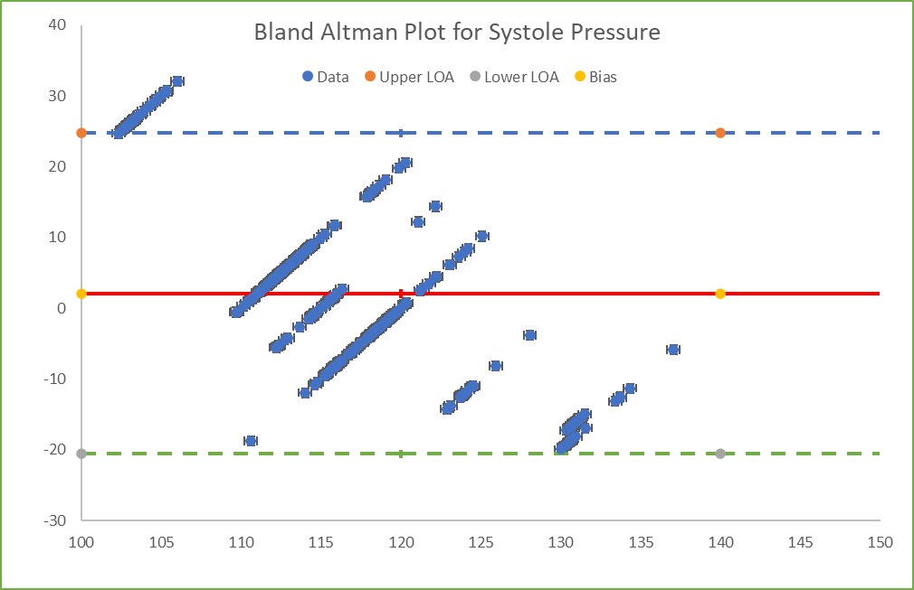
Performance Evaluation of BP: Systolic pressure
25
Figure 09: Error plot of BP:Systolic pressure in total Dataset with respect to Label..
Project: EEE-426

Slide 26
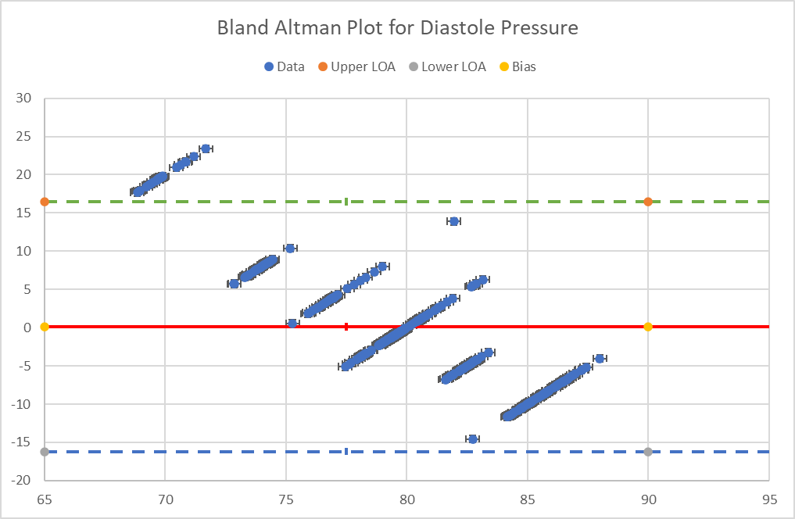
Performance Evaluation of BP: Diastolic pressure
26
Figure 09: Error plot of BP:Systolic pressure in total Dataset with respect to Label..
Project: EEE-426

Slide 27
Cost Analysis: Project cost
27
Name of components | cost
Microphone | 1200/-
Bluetooth Microphone | 700/-
Diaphragm(3x) | 900/-
Arduino Microcontroller(2x) | 800/-
Sphygmomanometer | 1500/-
Digital Sphygmomanometer | 3000/-
LCD display | 250/-
ECG sensor | 1200/-
ECG electrode | 1200/-
Miscellaneous | 2000/-
Total = TK 11,750/-
Project: EEE-426

Slide 28
Cost Analysis: Proto-type cost
28
Name of components | cost
Microphone | 1200/-
Diaphragm(1x) | 300/-
Arduino Microcontroller | 400/-
Rechargeable battery | 300/-
Miscellaneous | 300/-
Total: | Tk. 2400/=
Name of components | cost
Bluetooth Earphone | 700/-
Diaphragm(1x) | 300/-
Arduino Microcontroller | 400/-
Rechargeable battery | 300/-
Miscellaneous | 300/-
Total: | Tk. 2000/=
Setup-01: Wirable device
Setup-02: Bluetooth device
Project: EEE-426

Slide 29
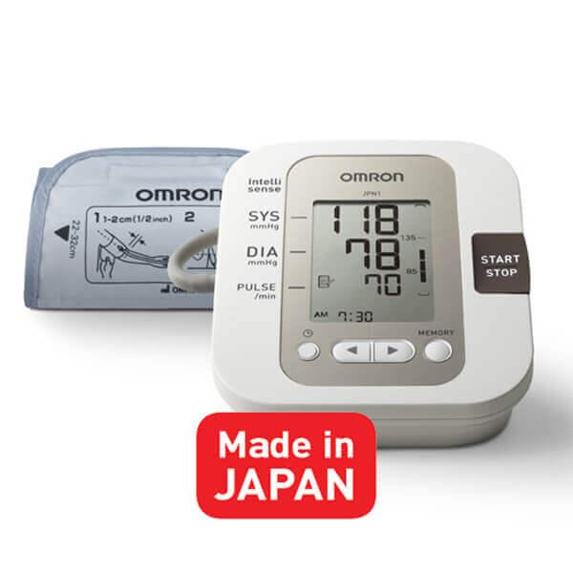






Cost Analysis
29
JPN1 Omron Digital Blood Pressure Monitor 11000/-
Laser Therapy Watch for Normal Blood Pressure Measurement 20000/-
Life Care Blood pressure monitor RAK-288
2700/-
Life Care Blood pressure monitor RAK-288
3000/-
Manual BP MACHINE
2000 /-
Our proposed device
2000 - 2200/-
Project: EEE-426

Slide 30

Future Prospects
30
This PhonoTrack device will be implement in Automated system by utilizing App Development for Mobile phone.
To Convert MATLAB code into C++ code which is compatible in Microcontroller.
To develop Audio recording module for Microcontroller.
To implement SD card module due to store data in Microcontroller.
SD card
module
C++
code
Microcontroller
Audio recording module
Displays
Project: EEE-426

Slide 31
31
Novelty/ Project outcome
PhonoTrack device is a continuous monitoring system based on HR and BP.
This project creates new dataset in real-time.
New empirical model for blood pressure was implemented here.
The design of PhonoTrack device was implemented by this project and is very simpler, cheaper, and low maintenance cost than other phonocardiogram device.
PhonoTrack is less noise-sensitive and the SNR of the PCG signal is very high.
Project: EEE-426

Slide 32
Conclusion
32
PhonoTrack is one kind of Phonocardiography that was implemented in this work and verified with the truth label data.
This project estimated the HR and BP from the PCG signal by using new algorithm and empirical model.
The error of HR is less than 5-10%.
For the BP error is less than 10-15%.
Future research development in sophisticated algorithms and cloud based deep learning artificial monitoring system.
Project: EEE-426

Slide 33


32
We are so grateful to…………
Shahed Ahmed
Md. Jahin Alam
Thanks, everyone for your patience
Project: EEE-426

